Slide 1
Deep Learning Based Feature Extraction Methods for Coyote Howling Detection
Mid-Presentation
Coyote2-Machine Learning

Slide 2
CONTENTS
01
02
03
Team Members
Introduction
Methodology
04
05
06
Contribution
Process
Q&A

Slide 3







Team Member
Yejin Lee
Heesun Jung
Youngbin Kim
Computer Science
Hallym University
Computer Science
Hallym University
Computer Engineering
Kwangwoon University
Bokyung Kwon
Jihyeon Park
Griffin Pegg
Computer Engineering
Kwangwoon University
Computer Science
Jeju National University
CNIT
Purdue University

Slide 4

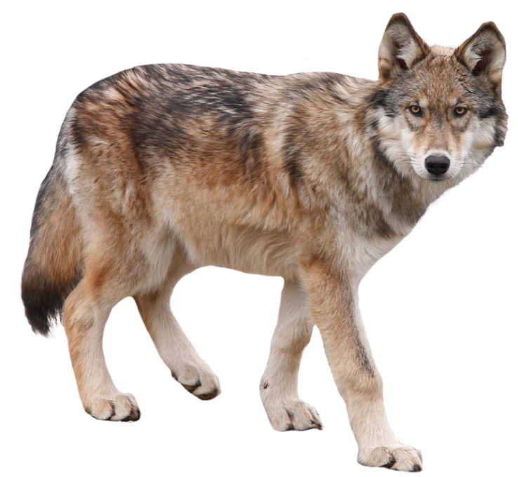
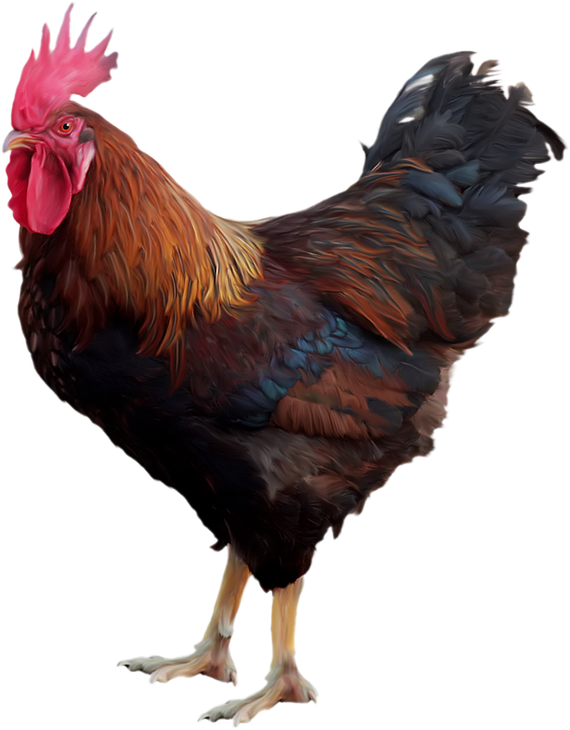
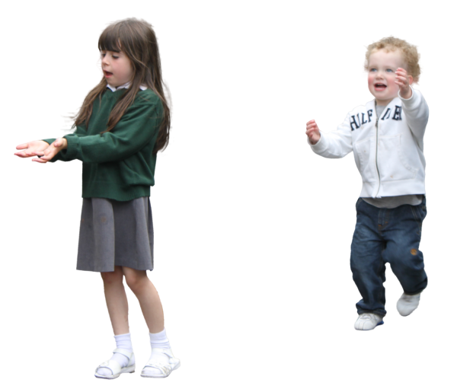
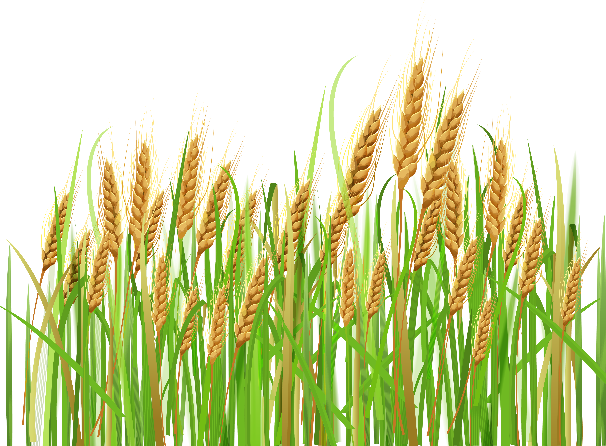
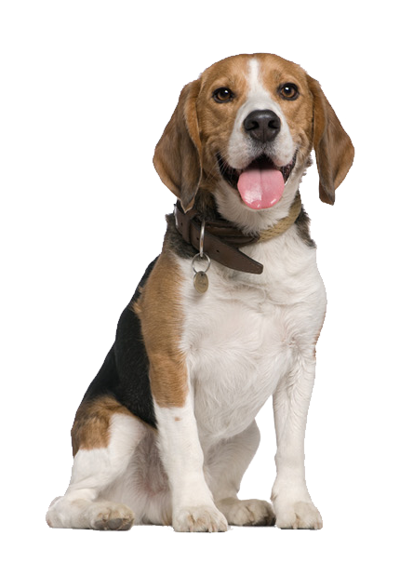
Introduction
There is substantial damage to livestock, human costs, and crops
by coyotes in several farms.
Continuous Economic Losses

Slide 5
Introduction
The number of livestock killed by coyotes among those killed by predators
[USDA, 2015]
But solving the problem with.. Non-technical approach
Technical Approach
is needed.

Slide 6
Introduction
💡 Platform Architecture
Raspberry PI
Network Team
Application
Server
MQTT
LTE/WIFI
Machine
Learning
- Figure out if it's coyote or not using ML model in Raspberry Pi.
- Input: audio feature from LoRa

Slide 7
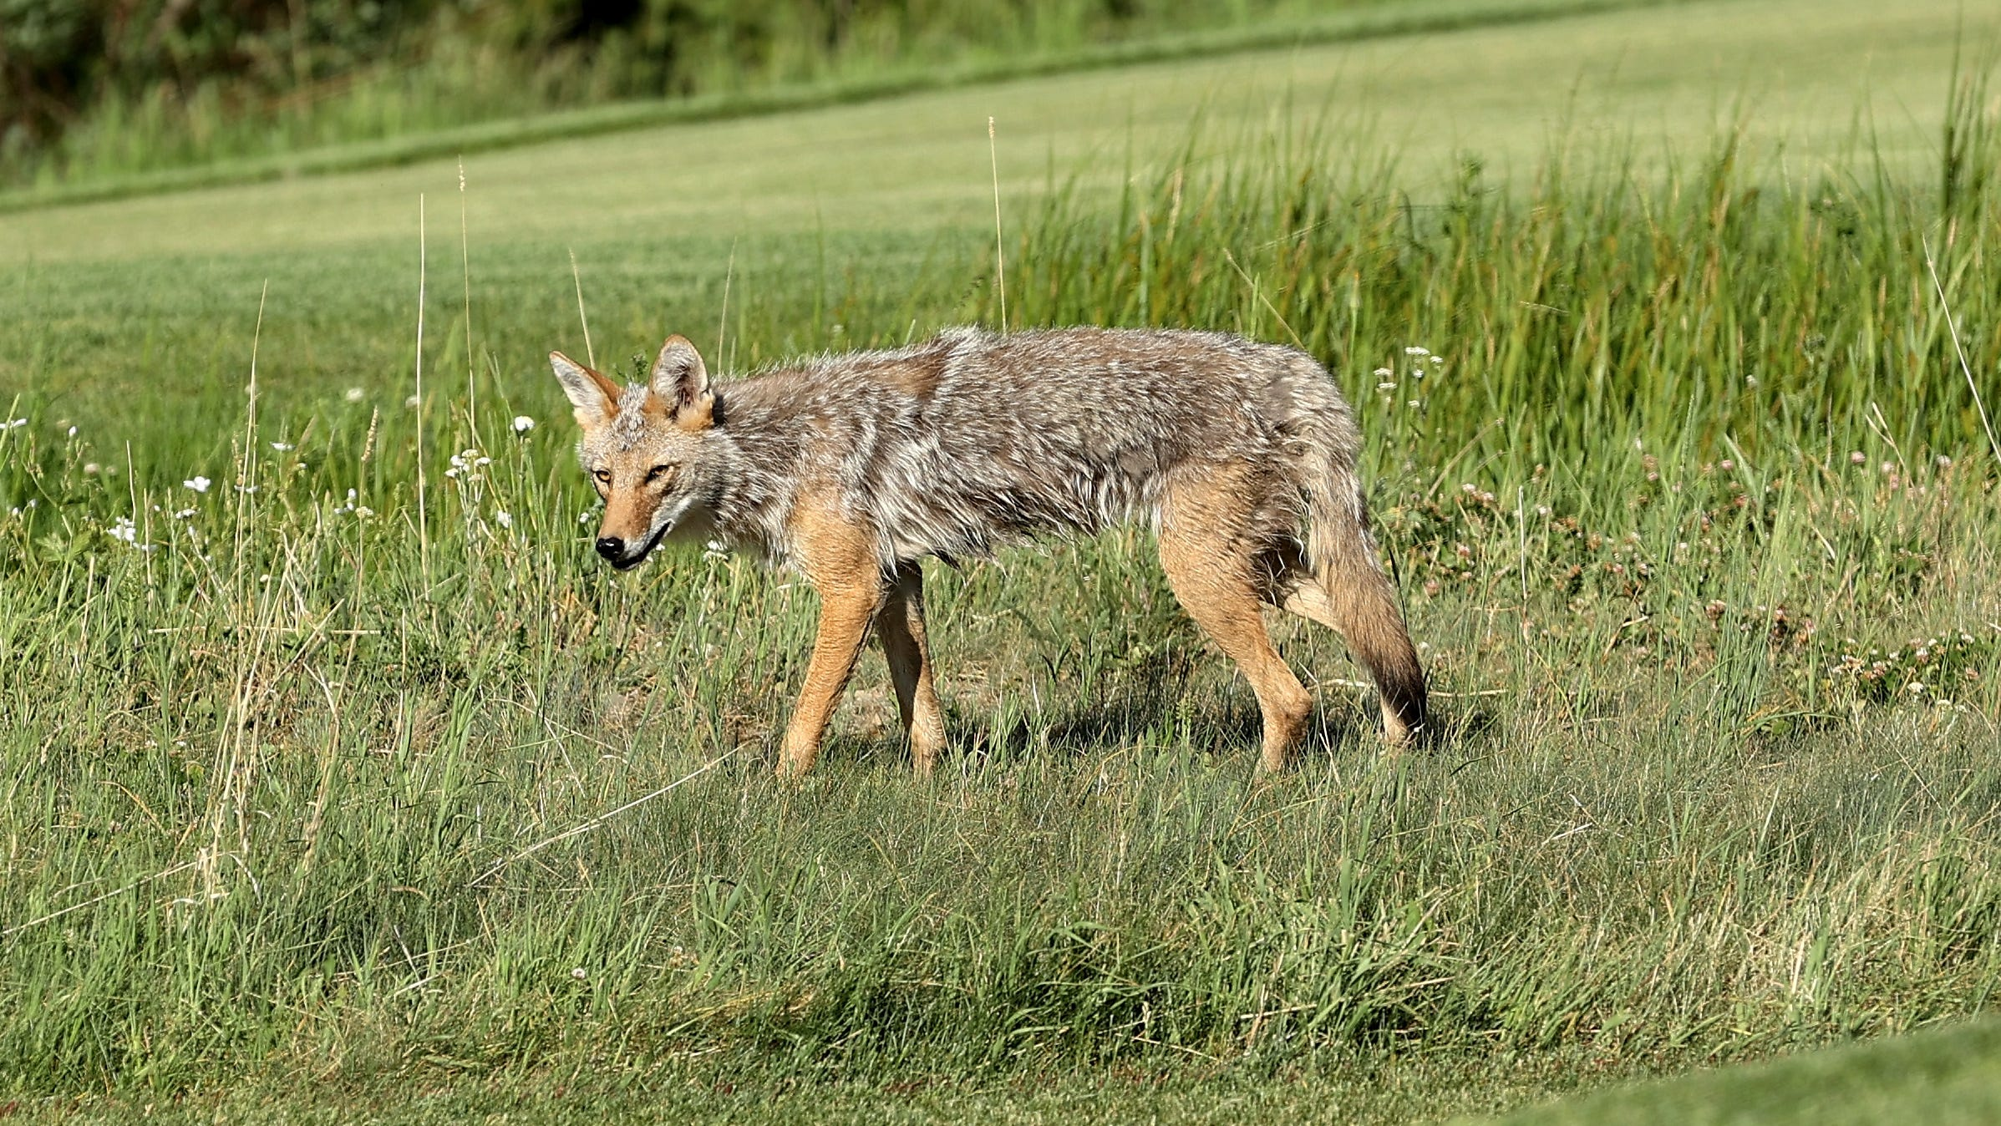

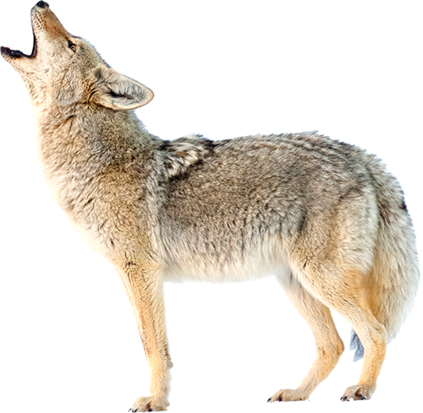
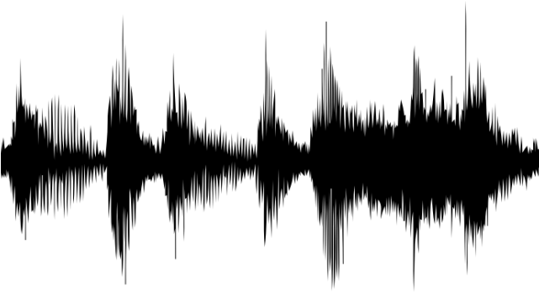
Introduction
💡 Common ways to detect coyote …
IMAGE
AUDIO
💡 AUDIO
- Coyotes have a habit of making frequent howling.
- The transmission distance range of the howling is higher than image.

Slide 8



Methodology
💡 Dataset problem
: clean, reliable data is needed but there is not enough dataset.
 | Coyote | Non-Coyote
Plan & Problem | - National Park Service - Colorado State University : Copyright, Data pre-processing Problem | Google Research Audio dataset : Data pre-processing Problem
Temporary | Extract audio from Youtube and split to 5 seconds

Slide 9
Methodology
134
117
29
💡 Train/Test Dataset
Coyote vs Non-coyote(dog, chicken…)
coyote | 586
dog | 480
chicken | 94
coyote | 134
dog | 117
chicken | 29
Non-coyote
Train data(80%)
Test data(20%)
TOTAL
Coyote : 720 Dog : 597 Chicken : 123

Slide 10
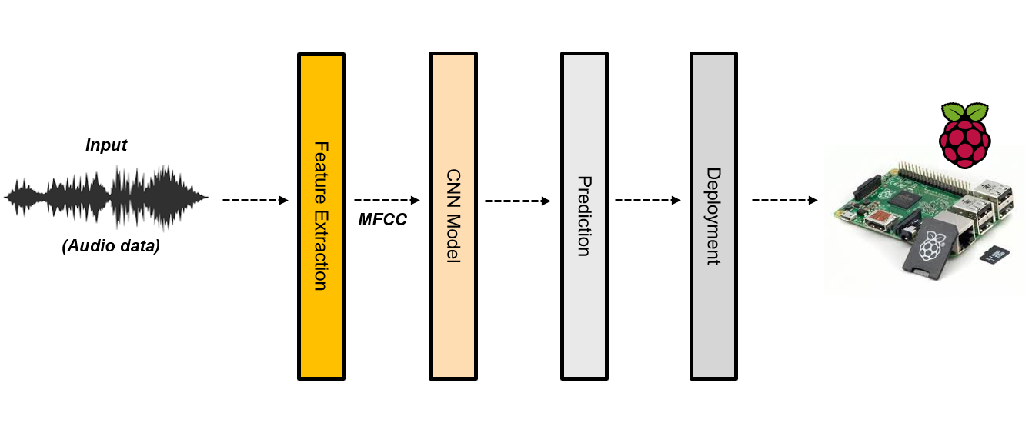
Methodology
💡 Machine Learning – Overall architecture

Slide 11
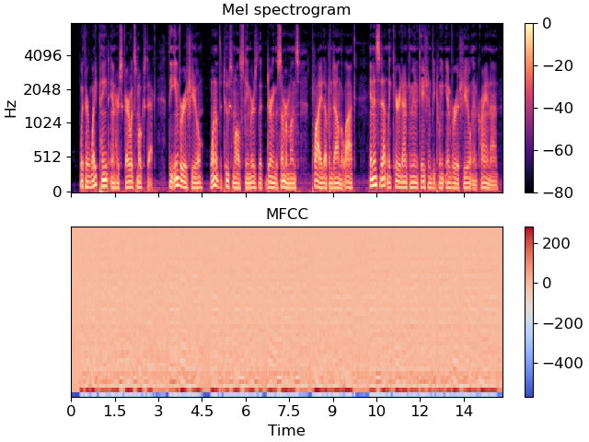
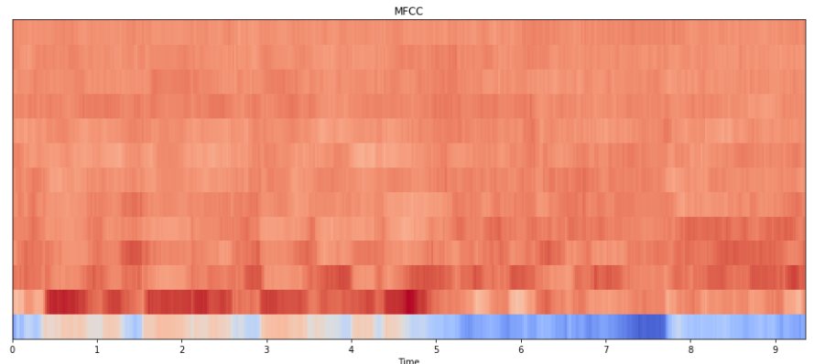
Methodology
💡 Feature Extraction
Mel Spectrogram
➡ A spectrogram where the frequencies are converted to the Mel scale
Gammatone Cepstral Coefficient(GTCC)
➡ Use a gammatone filer to extract an audio feature
➡ Use discrete cosine transform (DCT), to reduce the dimension of audio feature
Mel Frequency Cepstral Coefficient(MFCC)
➡ One of the most broadly used methods in audio recognition.
➡ Apply Filter Bank based on Mel Scale on Spectrum
Mel Spectrogram
MFCC
Combination of Features
Research have shown that the combination of several features makes better performance

Slide 12

Methodology
💡 Feature Extraction
Audio and music processing in Python
Extract features from sound files
Features were extracted and saved as binary files

Slide 13
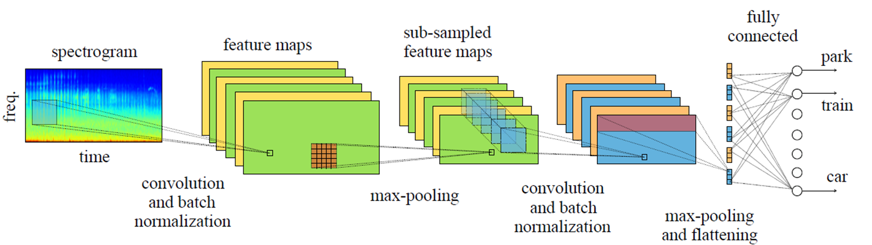
Methodology
💡 Convolutional Neural Network (CNN)
- Deep learning algorithm
- Uses numerous layers to detect different features
- Most commonly used to analyze image data, but can be used with audio data

Slide 14
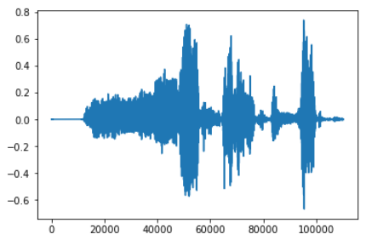
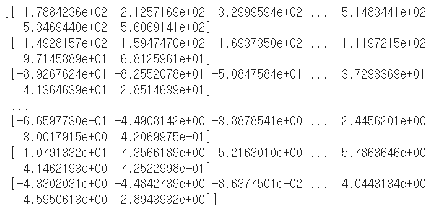
Methodology
💡 Audio Feature Training
Amplitude
Librosa
Sampling rate
.wav File
Audio Feature
MFCC

Slide 15
Methodology
- Model Architecture
Conv 2D
Fc Layer
Yes
Conv 2d
ReLU
Maxpool 2D
Conv 2D
Conv 2D
Conv 2d
ReLU
Maxpool 2D
Conv 2d
ReLU
Maxpool 2D
Conv 2D
Conv 2d
ReLU
Maxpool 2D
No
- Model Information
➢ Loss : CrossEntropyLoss
➢ Optimizer : Adam
➢ Learning rate : 0.001
➢ Batch size : 10
➢ Epoch : 100

Slide 16
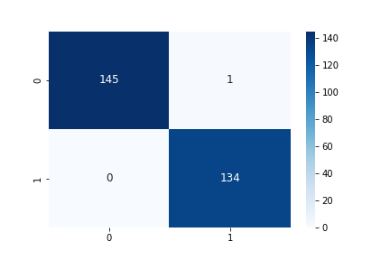
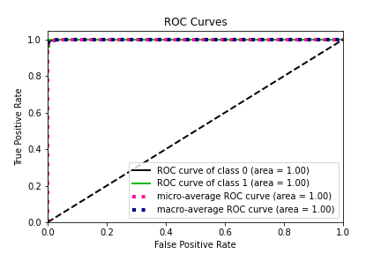
Experiment Result
- Confusion Matrix
- ROC curve
Test Loss: 0.0324
Accuracy: 279/280 (100%)

Slide 17


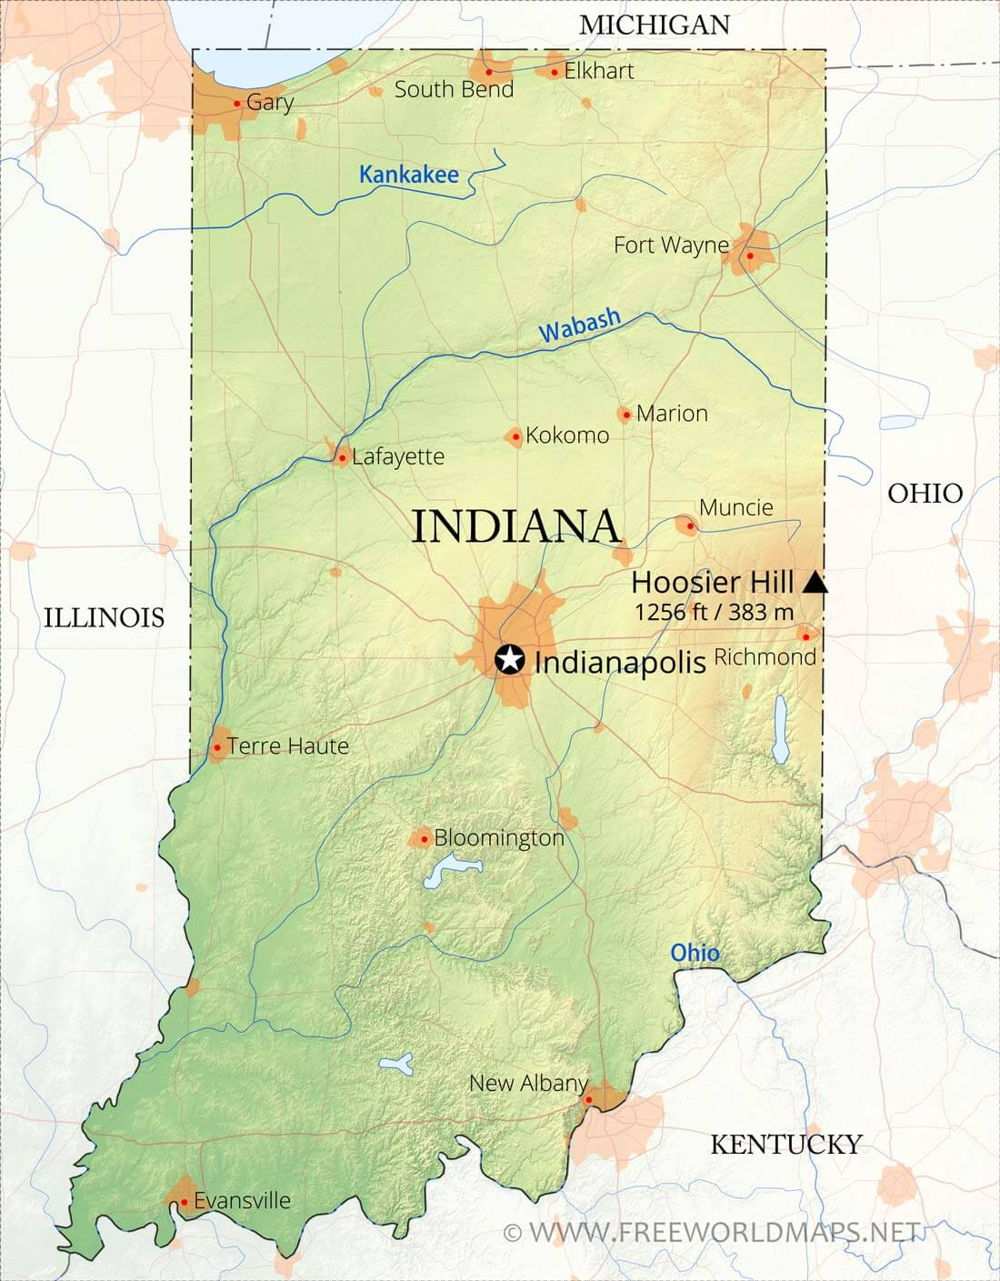


Contribution
Building Infrastructure
Increase efficiency in managing coyotes
➡By informing the surrounding farms to prevent damage,
using the frequency that coyotes dislike.
Reduce livestock, human costs, and crops damage
➡ by commercialization of coyote detection technology

Slide 18
Process
💡 Remaining work
Finding reliable dataset of coyote
Improving model performance
Writing paper
🔍 Current
- Basic CNN Model
➢ MFCC – CNN
➢ Mel-spectrogram(IMAGE) - CNN
🔍 Future
- Machine learning Model​
➢ For various combinations of Model and Feature Extraction
- Other feature extraction​
➢ MFCC – SVM
➢ Mel-spectrogram(IMAGE) - SVM​
➢ GTCC – CNN​

Slide 19
Process
💡 Gantt Chart
 | Sep. week2 | Sep. week3 | Sep. week4 | Oct. week1 | Oct. week2 | Oct. week3 | Oct. week4 | Nov. week1 | Nov. week2 | Nov. week3 | Nov. week4 | Dec. week1 | Dec. week2 | Dec. week3
ML Study
Related Work Study
Collecting Dataset
Data Preprocessing
Model Design
Writing Paper (MID)
Writing Paper (FINAL)
MFCC - CNN
Mel spectrogram - CNN
MFCC - SVM
Mel spectrogram - SVM
GTCC - CNN

Slide 20
References
[1] R. Tischaefer, “Coyotes,” in Wildlife Damage Management Technical Series. USDA. APHIS, 2020, p. 42.
[2] K. J. Piczak, “Environmental sound classification with convolutional neural networks,” in 2015 IEEE 25th international workshop on machine learning for signal processing (MLSP). IEEE, 2015, pp. 1–6.
[3] M. Valenti, A. Diment, G. Parascandolo, S. Squartini, and T. Virtanen, “Dcase 2016 acoustic scene classification using convolutional neural networks.” in DCASE, 2016, pp. 95–99.
[4] H. Xu, L. Lin, X. Sun, and H. Jin, “A new algorithm for auditory feature extraction,” in 2012 International Conference on Communication Systems and Network Technologies. IEEE, 2012, pp. 229–232.
[5] M. Ramashini, P. E. Abas, K. Mohanchandra, and L. C. De Silva, “Robust cepstral feature for bird sound classification,” International Journal of Electrical and Computer Engineering, vol. 12, no. 2, p. 1477, 2022.
[6] X. Valero and F. Alias, “Gammatone cepstral coefficients: Biologically inspired features for non-speech audio classification,” IEEE Transactions on Multimedia, vol. 14, no. 6, pp. 1684–1689, 2012.
[7] W. Xu, X. Zhang, L. Yao, W. Xue, and B. Wei, “A multi-view cnn-based acoustic classification system for automatic animal species identification,” Ad Hoc Networks, vol. 102, p. 102115, 2020.
[8] D. Bonet-Sol`a and R. M. Alsina-Pag`es, “A comparative survey of feature extraction and machine learning methods in diverse acoustic environments,” Sensors, vol. 21, no. 4, p. 1274, 2021

Slide 21
Q & A

Slide 22
Thank You

